Slide 1
End of Louis XIV Notes
Peace of Utrecht (1713)
Ends War of Spanish Succession (1701-1714)
Grand Alliance Vs France for control of Spanish Empire
Louis’ grandson takes Spanish throne, Promise to never unite
Peace represents idea of “Balance of Power”
France gets Alsace, English get parts of Canada, slave trade, Gibralter, Austria gets Belgium, Prussia created
Numerous wars leave treasury depleted
France is most powerful, populous nation in W. Europe

Slide 2
Rise and Fall of Spain

Slide 3
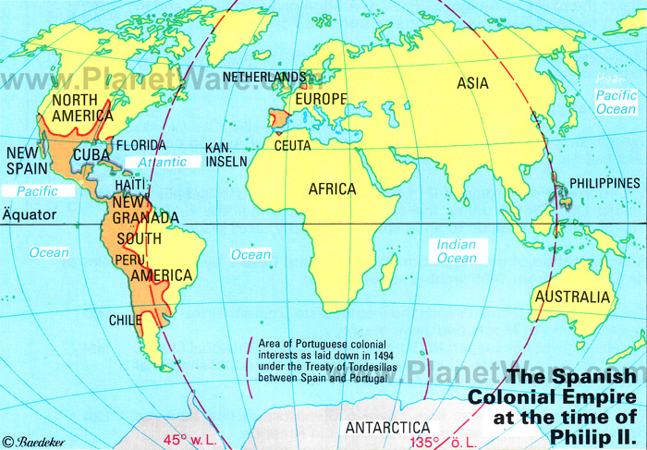

Slide 4
Spain’s “Golden Age”
16th Century
Large overseas empire
Gold & Silver bring wealth and power
Absolutist Monarch
Permanent Bureaucracy
Standing Army
National Taxes

Slide 5
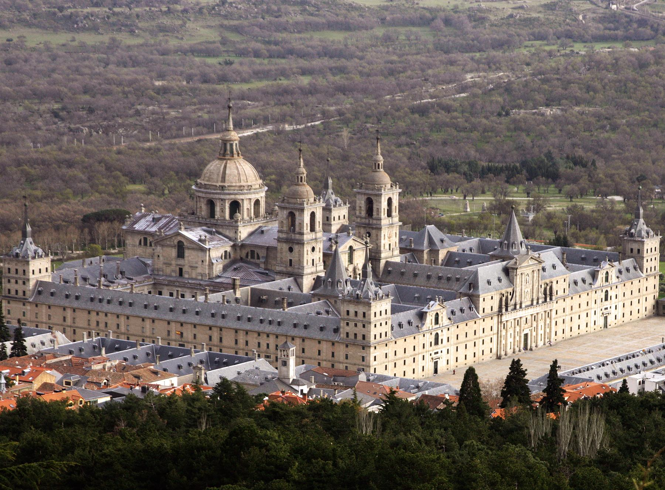
Escorial Palace

Slide 6
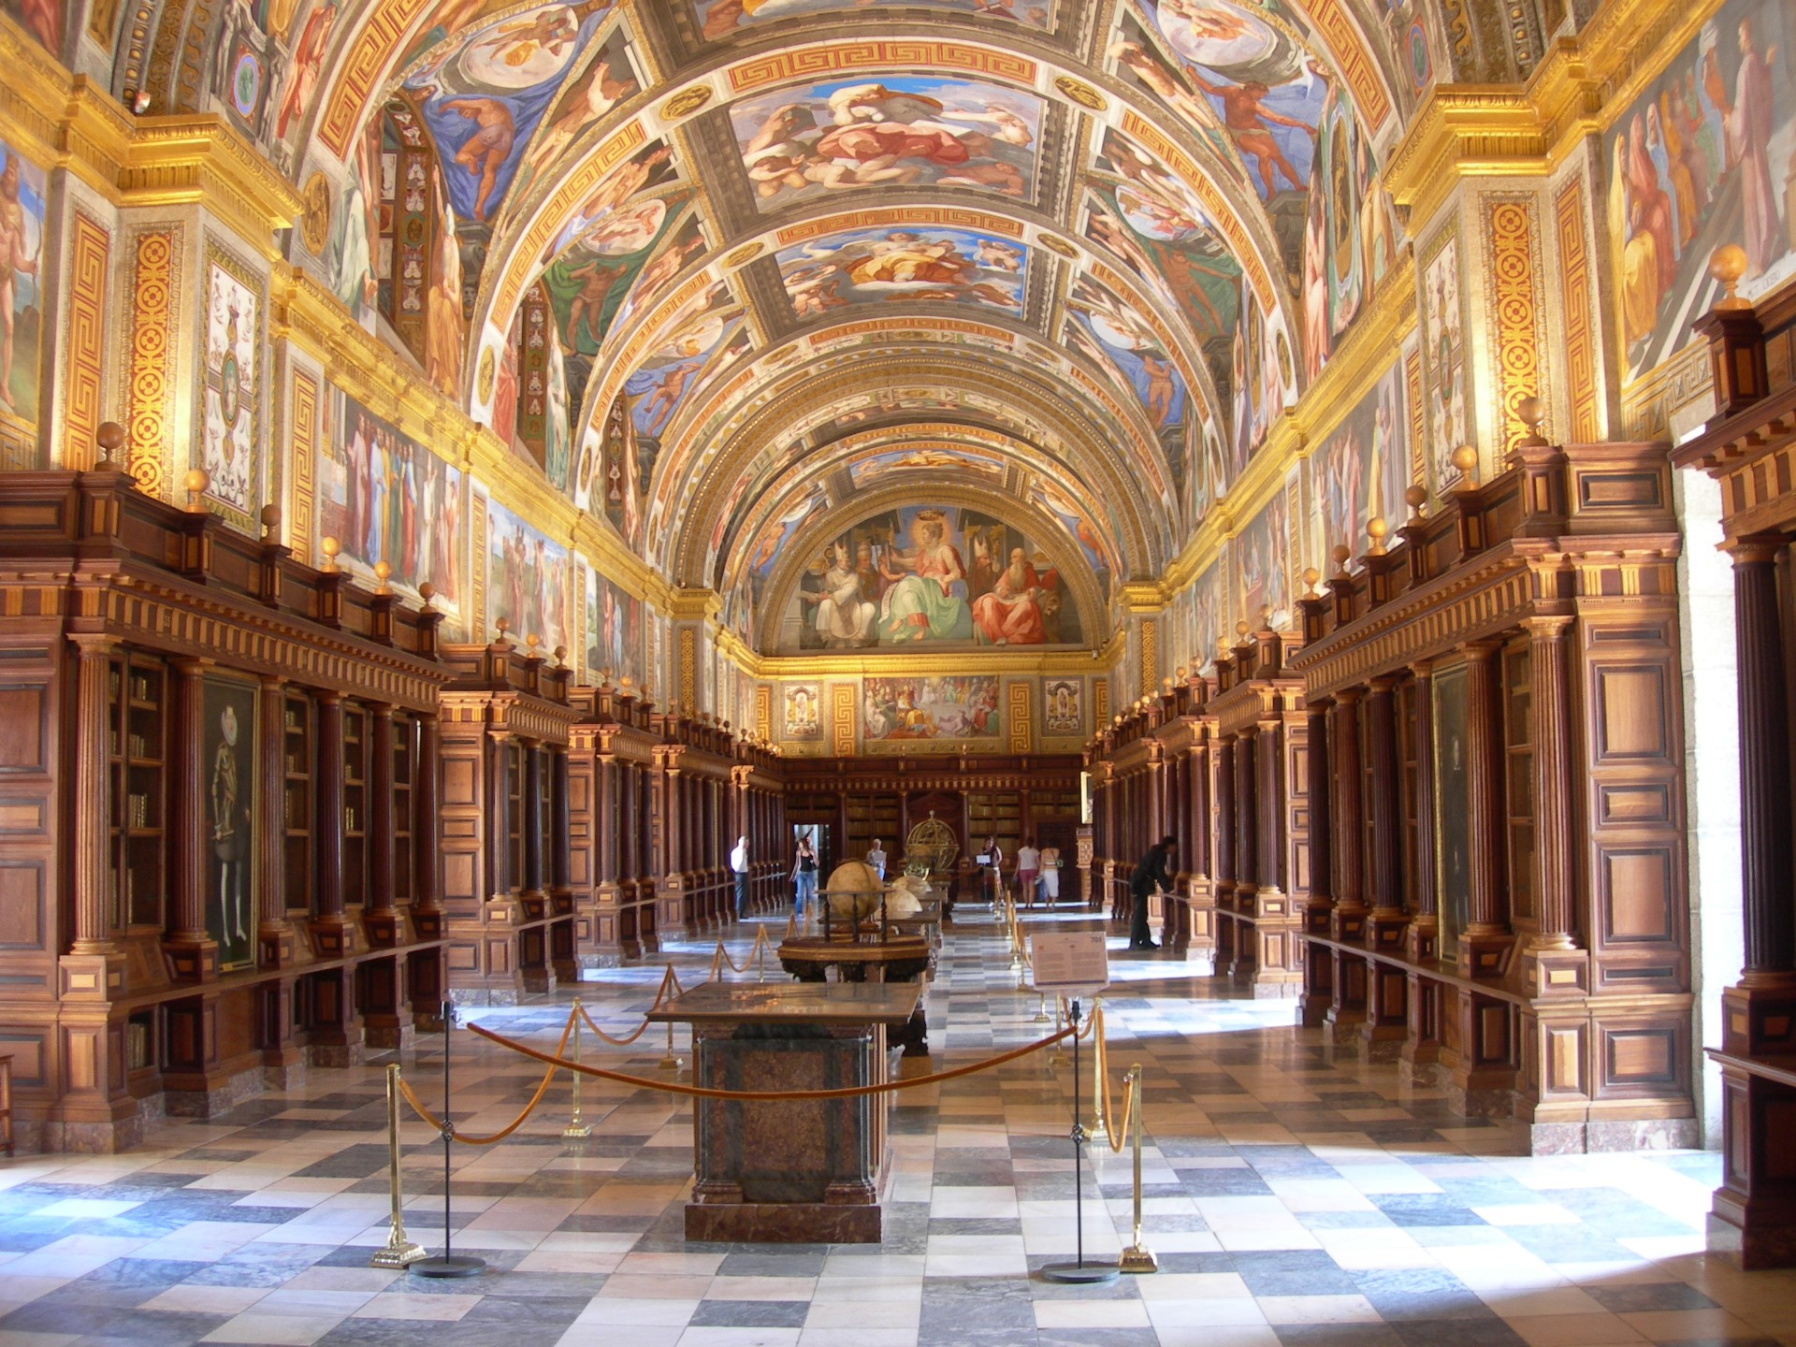

Slide 7
Problems Begin (Early 17th Cen.)
Agricultural crisis and population decline
Flow of Gold & Silver slow after causing inflation
Loss of Merchants & artisans
Philip III’s expulsion of Moriscos
Growth of local industries in colonies hurt Spanish business
Massive deficit spending creates debt & bankruptcy

Slide 8
Further Decline
Moneymaking is looked down upon
Wars further economic decline
Aristocrats staff royal councils

Slide 9
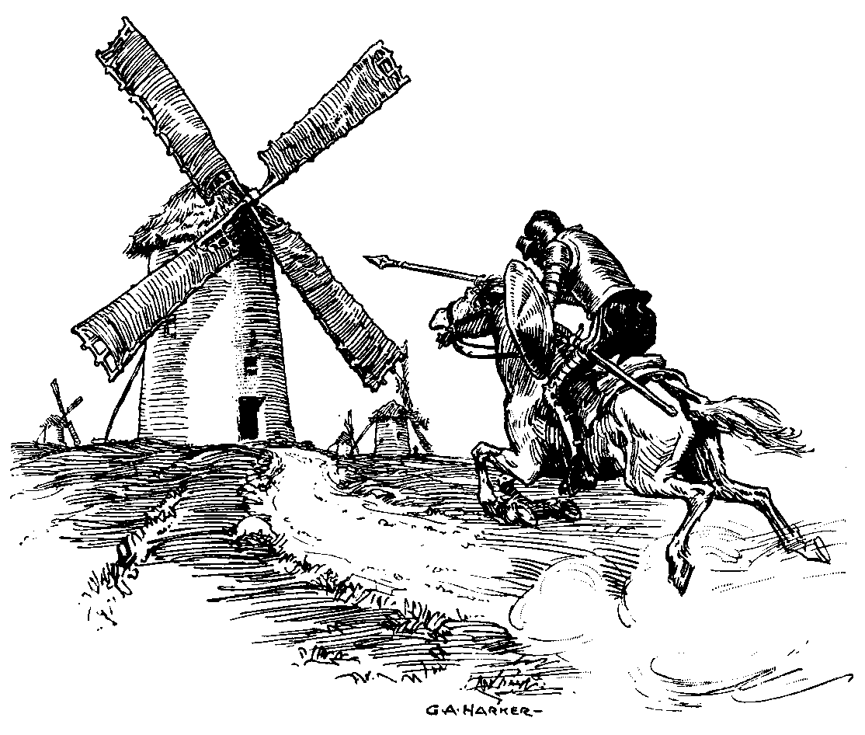
Don Quixote
By Miguel de Cervantes
Describes social decline in the Spanish Empire in the person of a deluded, fake, knight

Slide 10
The Art of Absolutism

Slide 11
The Baroque Style
Ornate, Over the Top, gaudy
Vivid Colors, bold use of light and shadow
Rather than focus on lines
Dynamic more important than detail
Meant to inspire awe, overwhelm the viewer
With grandeur and emotion
Used by the Catholic Church as part of the Counter-Reformation
Used by Absolutists to express their power

Slide 12
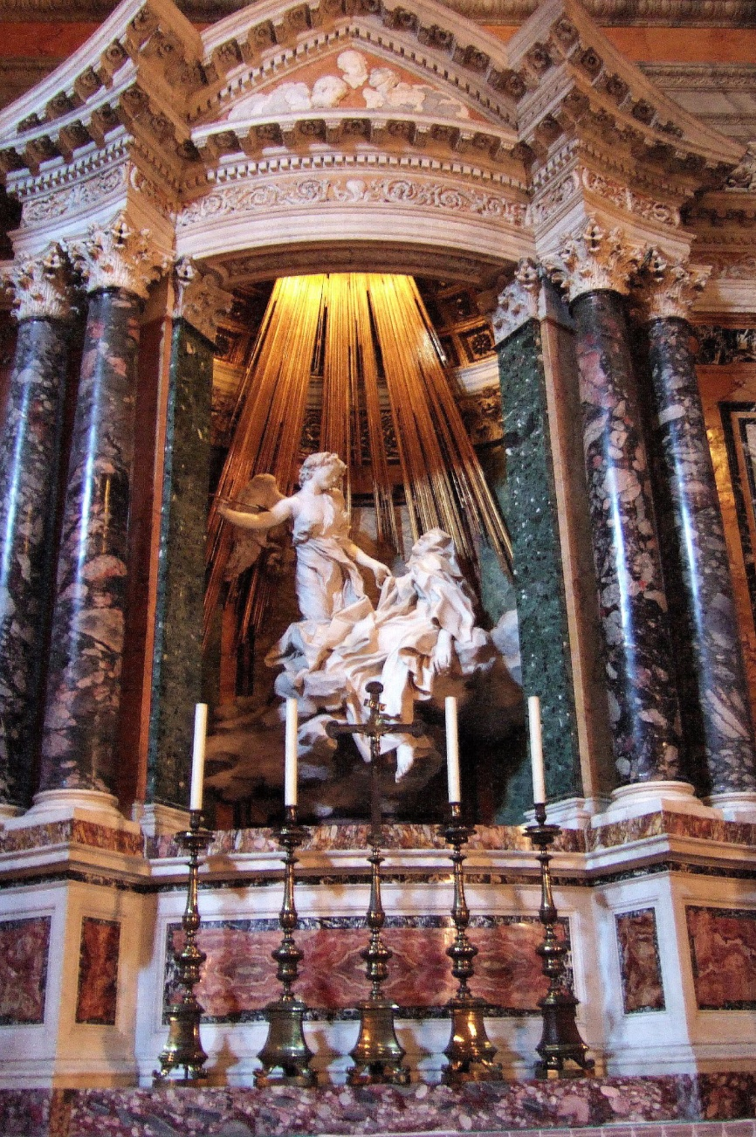
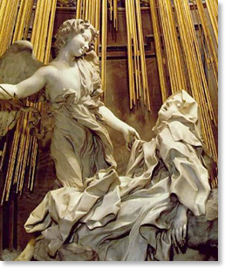
The Ecstasy of St Teresa, Bernini

Slide 13
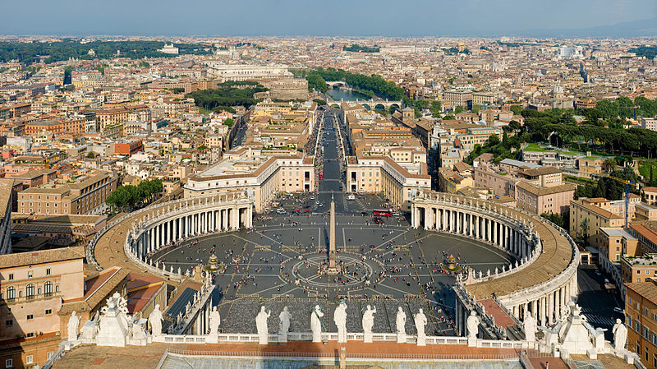
Colonnade at St. Peters, Bernini

Slide 14
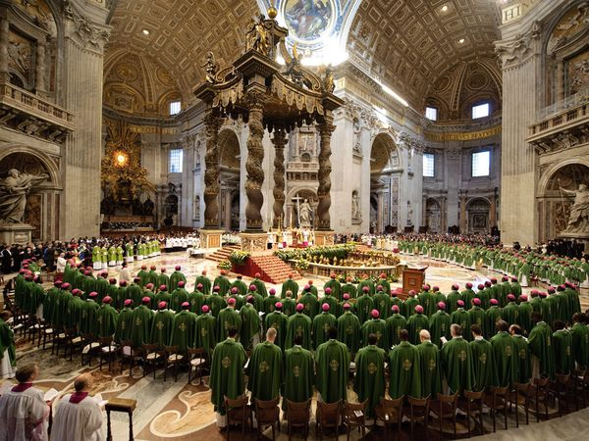
St Peter’s High Altar, Bernini

Slide 15
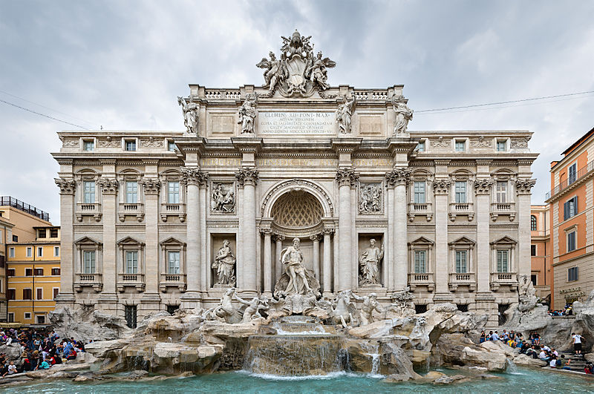

Slide 16
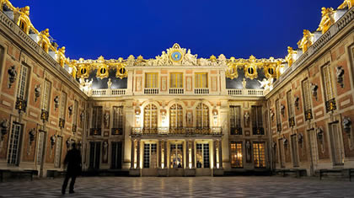
Palace of Versailles

Slide 17
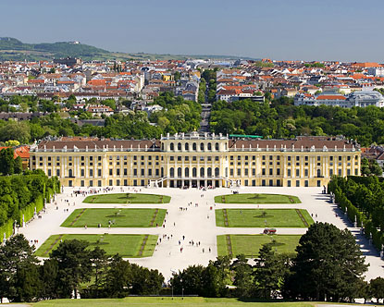
Schonnbrunn

Slide 18
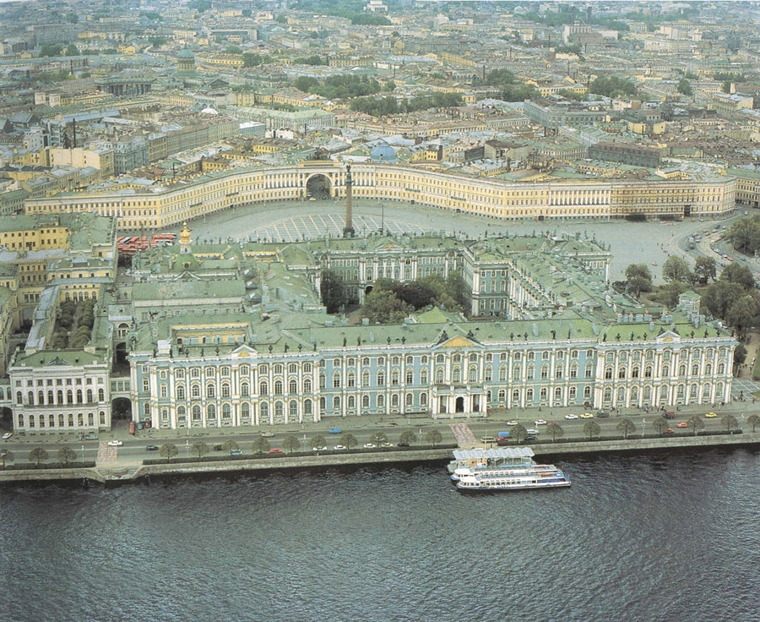
Peter’s Winter Palace

Slide 19
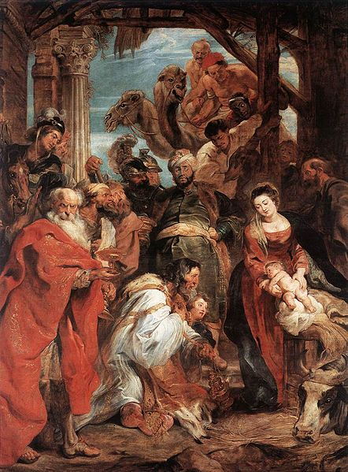
Adoration by Peter Paul Rubens
Animated figures
Color

Slide 20
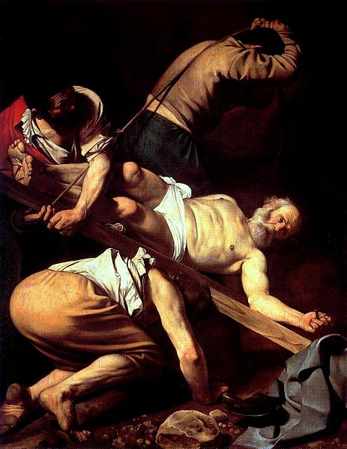
Crucifixion of St Peter, Caravaggio
Emotional
Deep Contrasts

Slide 21
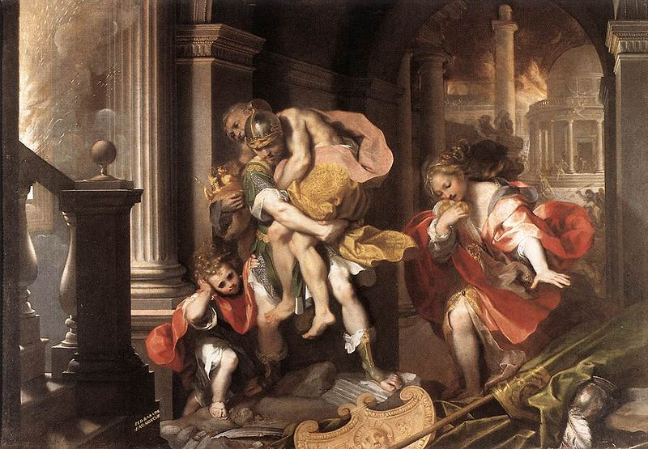

Slide 22
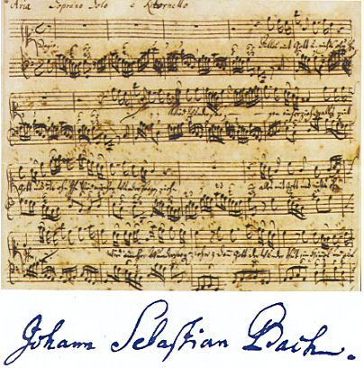
J.S. Bach
Dense, polyphonic
Choral & instrumental

Slide 23
George Handel

