Slide 1
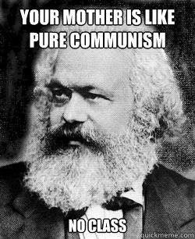

Slide 3
Romanticism (ca 1800-1850)

Slide 4
Artistic movement characterized by
Emphasis on emotion over reason
Reaction to the Enlightenment & Classicism
Glorification of Nature
Its power and awesomeness
Disturbed by the Industrial Revolution
Individualism
Liberalism
Emphasis on History
Supportive of nationalist movements
(esp. in Greece)

Slide 5
Poetry
William Wordsworth
English poetry inspired by nature
Lord Byron
“Don Juan”- Free expressions of emotion
Dies fighting in Greece- Nationalist uprising
Percy Shelley
“Prometheus Unbound”- Struggle between Good Vs Evil

Slide 6
Literature
Johann von Goethe
“Faust”- Criticizes rationality
George Sand
Romantic poetry- Actually a liberal woman
Victor Hugo
“Hunchback of Notre Dame”- Human Emotions
“Les Miserables”
Grimm’s Fairy Tales
Preserve German folk stories
Johann Herder
Promotes German Nationalism
Nikolai Gogol
“The Inspector General”

Slide 7
Art

Slide 8
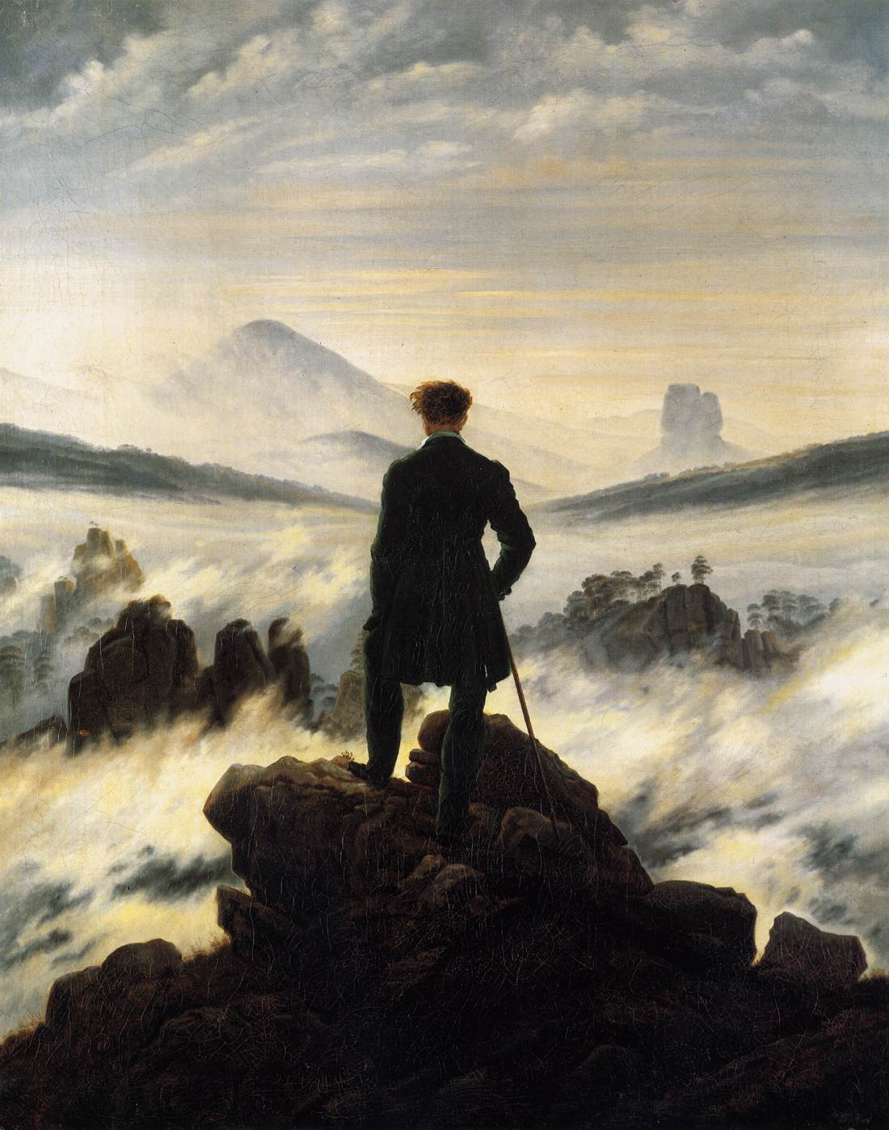
Caspar Friedrich
“Wanderer above
the Mist”

Slide 10
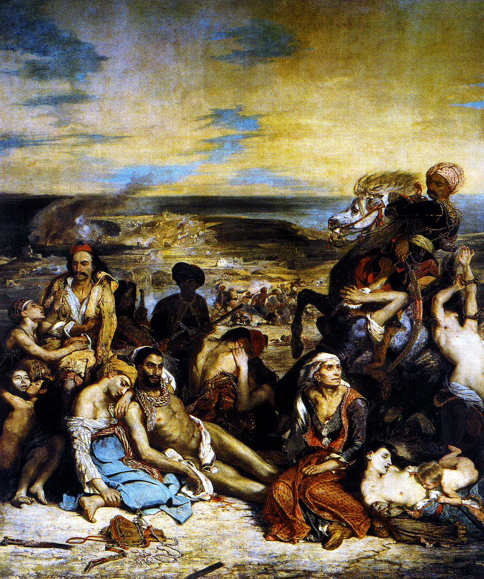
Eugene Delacroix
“Massacre at Chios”
Persecution of
Greek Christians

Slide 12
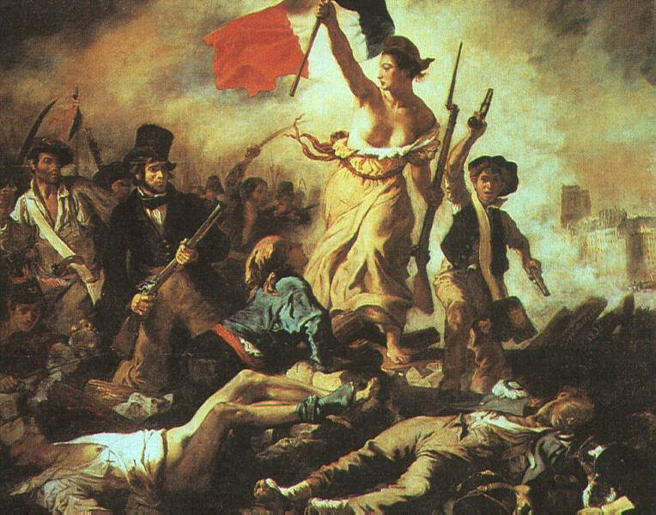
Eugene Delacroix
“Liberty Leading the People”
Idealized Liberal revolution

Slide 14
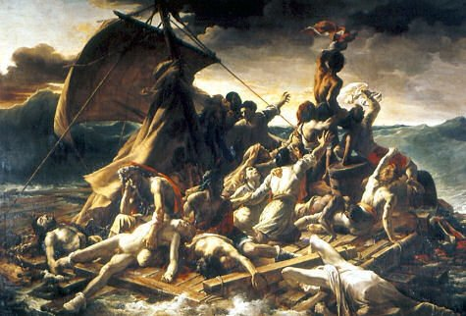
Theodore Gericault
“Raft of the Medusa”
Nature’s power, accuses the French Monarch

Slide 16
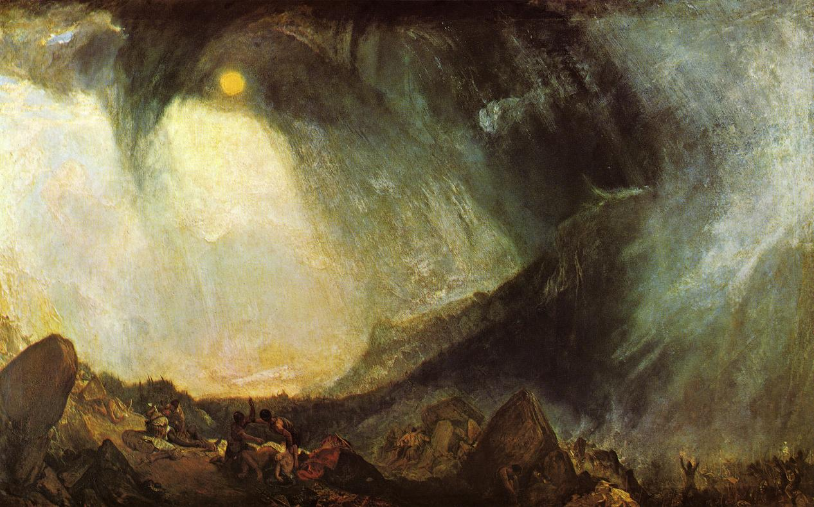
JMW Turner
“Hannibal Crossing the Alps”
Nature’s power

Slide 18
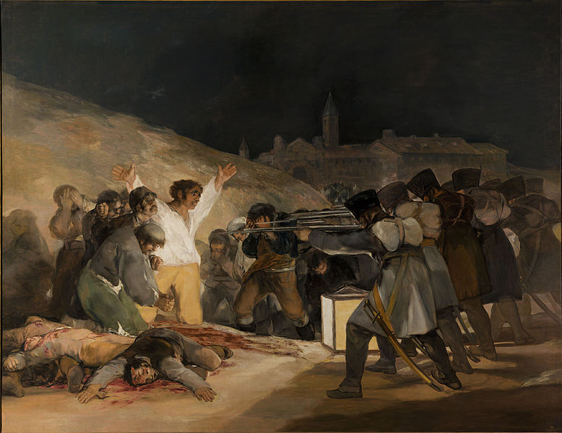
Francisco Goya
Third of May 1808
Spanish Nationalism

Slide 20
Music
Beethoven- Religious poetry with music
“9th Symphony,” “Ode to Joy”
Schubert- German nationalism
Chopin- Polish Folk Songs
Franz Liszt- Hungarian Rhapsody

Slide 21
Music
Guiseppi Verdi- Italian Nationalism
Richard Wagner- Emphasized Germanic legends
“Flight of the Valkyries”
Antonin Dvorak- Bohemian Folk music
Petr Tchaikovsky- Nationalism and Folk Songs
1812 Overture, Nutcracker, Swan Lake

