Slide 1
The Global Economy in the 18th C.

Slide 2
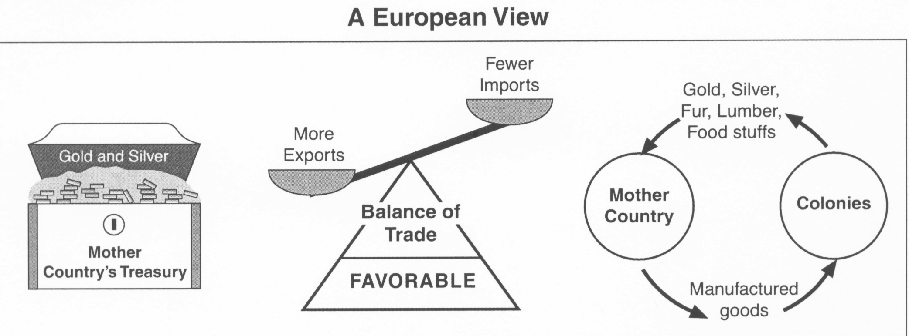
Mercantilism

Slide 3
The Rise of the English
Become a trading and colonial power
Navigation Acts of 1651 & later
Require that cargo be brought to England on English ships, or by country of origin
Aims to weaken Dutch shipping
Gave British Merchants trade monopoly with colonies
Develops shipping industry and royal navy

Slide 4
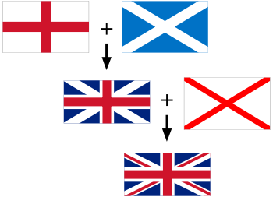
The Rise of the English
Act of Union 1707- Unites England and Scotland, creating Great Britain
Act of Union 1801- Unites with Ireland

Slide 5
French Competition
Rival the British
Wealth, resources, 4x population, allied with Spain
Wars
Of Spanish Succession
Gives Brits all of Canada
Of Austrian Succession
Fight over access to India
7 Years War
Treaty of Paris of 1763 forces France out of North America and India

Slide 6
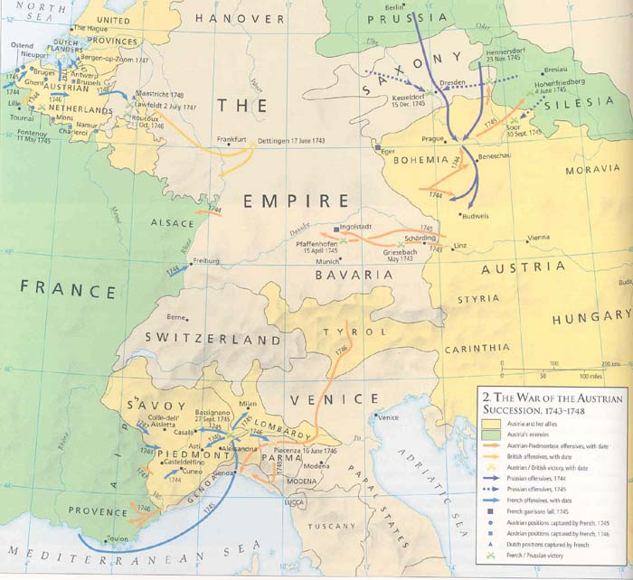

Slide 7
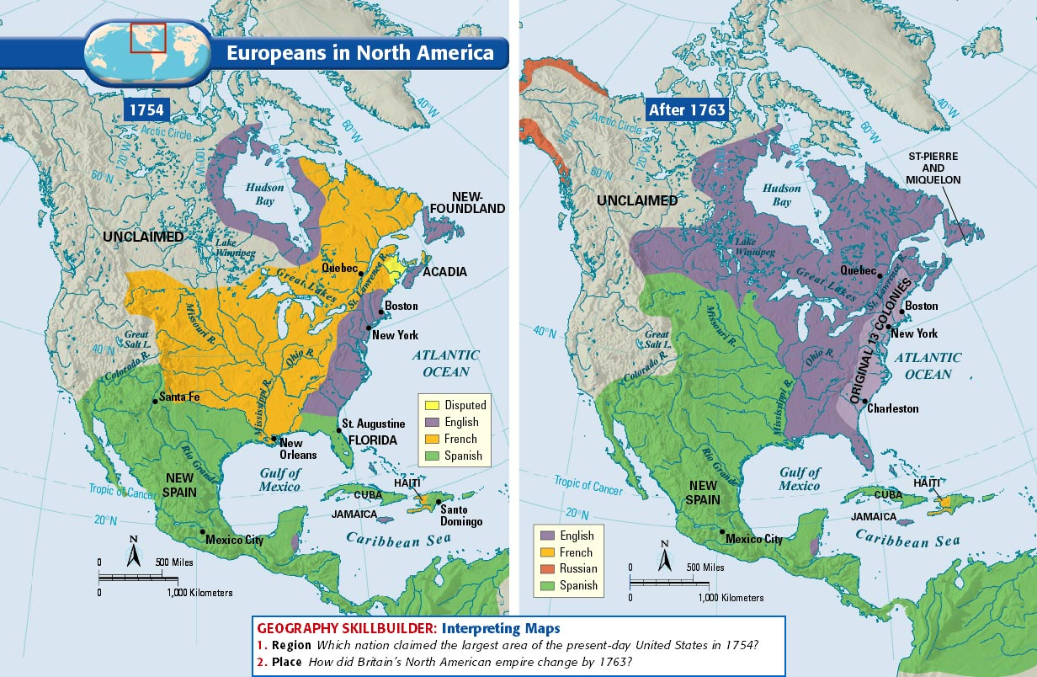

Slide 8
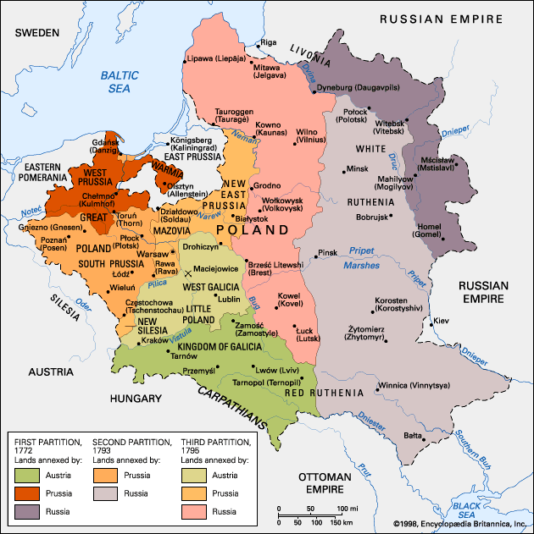

Slide 10
Importance of Colonies
Source of National Pride
Provide Wealth from Cash Crops and Natural Resources
Create markets for manufactured goods

Slide 11
British America
Cheap land creates opportunity
Slavery accounts for as much as 20% of pop.
Plantation cash crops Southern colonies

Slide 12
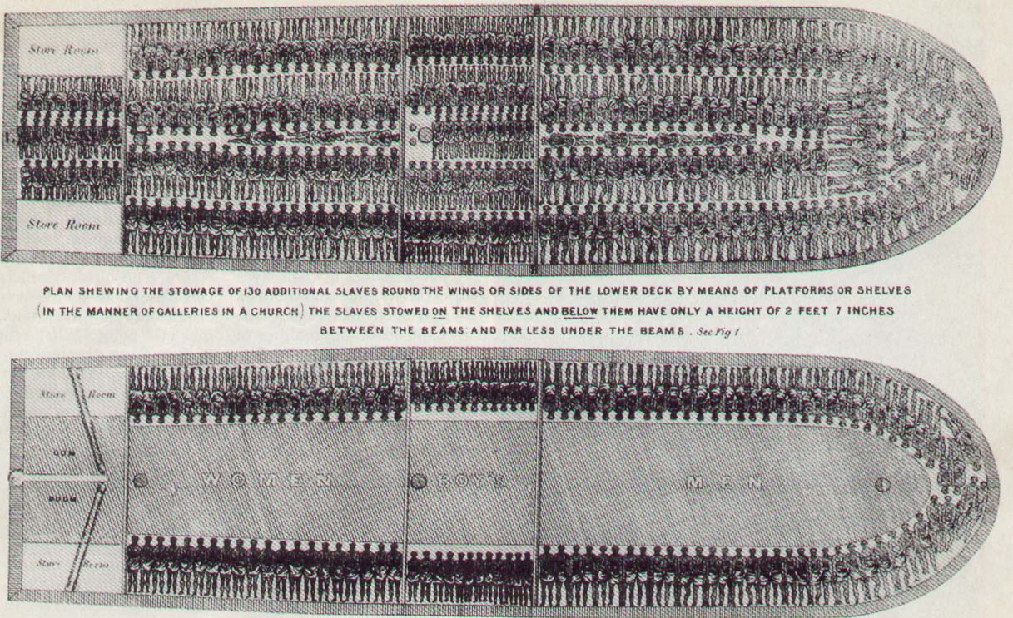
The Slave Trade
“Triangle Trade”
Slaves provide labor for cash crops
In South
Banned by Brits in 1807

Slide 13
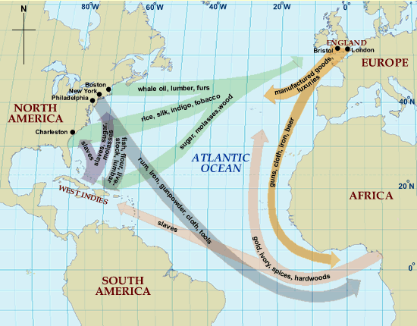

Slide 14
The Global Economy in the 18th c. pt 2

Slide 15
Spain Rebounds
Under Philip V (Bourbon)
Reformist ministers, economic prosperity
American silver mines produce again

Slide 16
Class in Latin America
Peninsulares
Creoles
Mestizos
Mulattos
Africans
Natives

Slide 17
British Trade with Asia
Spices, spices, spices
1716 British get wide trade rights from Mughal of India
Intervene, become local players
Take French holdings after 7 Years War
1764 British East India Co. defeats Mughals, take control of India directly
“Jewel in the British Crown”

Slide 18
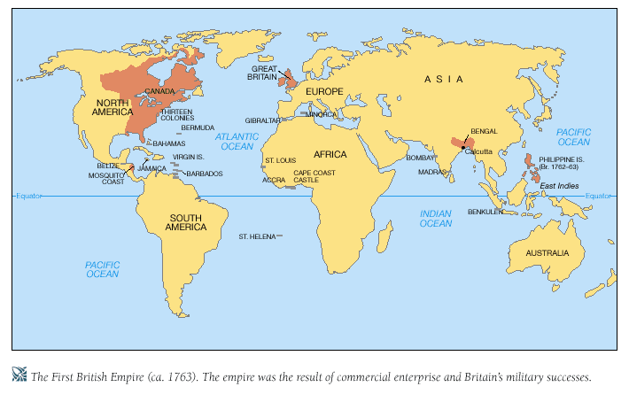

Slide 20
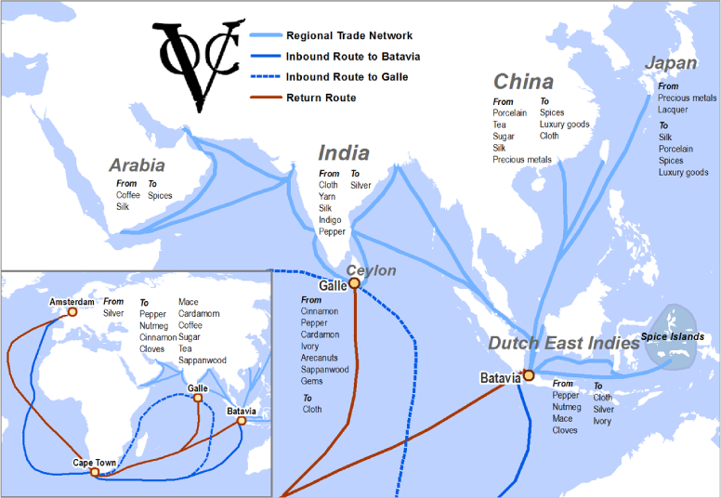
Dutch Trade with Asia
Dutch push Portuguese out of Asia in early 17th c.
Decline due to focus on spices

Slide 21
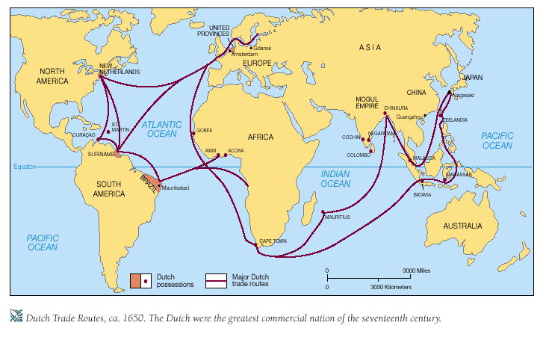

Slide 22
Economic Liberalism
Economic freedom over strong government control (Mercantilism, government monopolies)
Independent/ Small merchants favor

Slide 23
Adam Smith (1723-1790)
Scottish Economist
Wealth of Nations 1776
Provides Basic tenets of capitalism
Law of competition
Law of self interest
Law of Supply and Demand
“laissez faire,” free market, the “invisible hand”
3 government duties
Civil defense, order, and public works

