Slide 1
The Revolution Continues

Slide 2
Religious Reform
Civil Constitution of the Clergy brings the church under state control 7/90
Sells church land to pay off national debts
Create the “Assignats,” bonds backed by church land sales, used like currency
Closes religious orders
Forces clerical oath to state
Condemned by Pope
Divides French

Slide 3
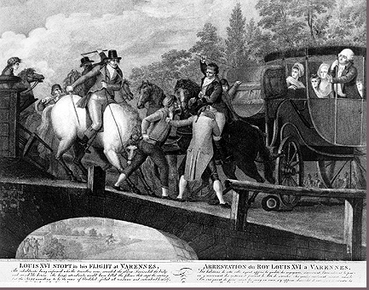
Failed Royal Escape 6/91
Royals attempt escape to Austrian Netherlands
Hopes to rally with emigres, reconquer France
Makes Louis look like a traitor
Gives power to enemies

Slide 4
Declaration of Pillnitz 8/27/1791
Austrian Emperor and Prussian King issue statement intending to support monarchy in France
Support Marie, afraid of revolutionary ideas spreading
Great Britain refuses, making it practically meaningless
Scares and angers the French

Slide 5
Foreign critics
Englishman Edmund Burke, conservative who defends hereditary privilege
Englishwoman Mary Wollstonecraft, calls for legal and social equality for women

Slide 6
1st Constitution 9/1791
National Assembly becomes Legislative Assembly
All new members
Dominated by the more revolutionary “Jacobins”
Creates constitutional monarchy
Divide power between king and Leg. Assem.
Louis reluctantly agrees

Slide 7
War 1792
Legislative Assembly declares war on Austria & Prussia (The First Coalition)
France invaded
Distracted by partition of Poland, France is able to regroup
King and Queen forced to seek protection in L.A. after palace is attacked due to rumors of treachery

Slide 8
National Convention
Louis XVI is stripped of all duties and imprisoned (8/1792)
Signals beginning of the “Second Revolution” or the “Radical Phase”
New “National Convention” replaces Legislative Assembly

