Slide 1
The Thirty Years War 1618-1648

Slide 2
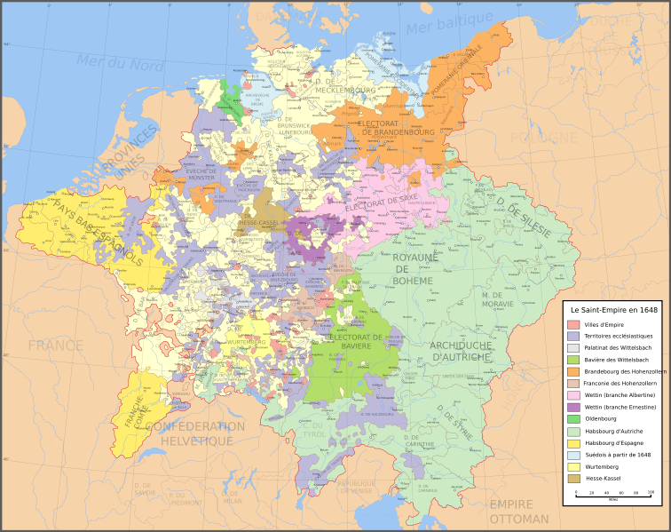

Slide 3
Alliances
Protestant Union formed 1608, Catholic League formed 1609
German princes seek protection from each other

Slide 4
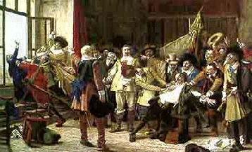
War Begins
Ferdinand, Catholic King of Bohemia closes Protestant churches
Defenestration of Prague, Ferdinand’s officials thrown from window
Beginning of 30 Years War

Slide 5
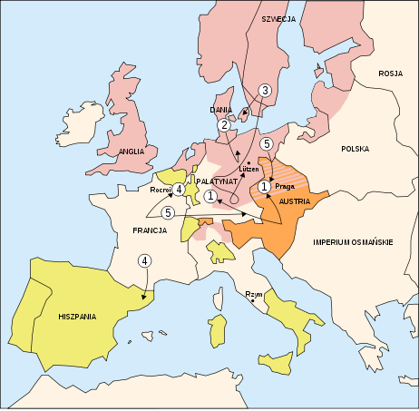

Slide 6
1st Phase (Bohemian Phase)
Civil War in Bohemia
Catholics Vs Protestants
Ferdinand wins, elected Holy Roman Empire
Forces Bohemia to convert

Slide 7
2nd Phase (Danish Phase)
Protestant, Christian IV of Denmark invades
Catholics win more victories under leadership of mercenary Albert Wallenstein
Seeks to create his own empire
Catholic forces divided

Slide 8
Edict of Restitution 1629
Only Catholicism and Lutheranism allowed, no Calvinism
Restores lost Catholic lands to 1552 owners

Slide 9
3rd Phase (Swedish Phase)
Gustavus Adolphus of Sweden comes to aid Protestants
With financial support of France and Cardinal Richelieu
Seek to weaken Habsburg power

Slide 10
4th Phase (French/ International Phase)
French openly join the war
Declare war on Spain
Ends Habsburg hope of a unified Germany
War drags on killing millions and hurting German economy and agriculture

Slide 11
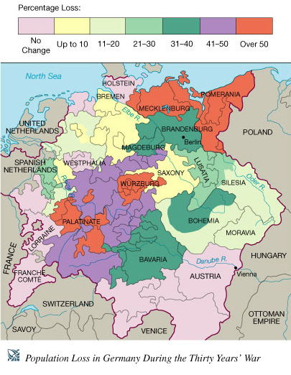

Slide 12
Peace of Westphalia 1648
End of Religious Wars, reconfirms Peace of Augsburg, allows Calvinism
Increases independence of German Princes
Weakens HRE, ensuring disunity
Pope shut out of German affairs
Spain & Austria weakened
France gets territory of Alsace
Sweden gets money and Baltic states
Dutch and Swiss gain independence

