Slide 1
Threats to Peace

Slide 2
Japan
Military takes over shortly after the Great Depression begins
Leave Emperor in place
Extreme nationalists
Seek to create “Greater East Asian Co-Prosperity Sphere
Expanded Japanese Empire
Desire raw materials and markets for industrial goods

Slide 3
Invasion of Manchuria (Sep 1931)
Japan invades for resources (iron and coal)
League of Nations protests, Japan quits League

Slide 4
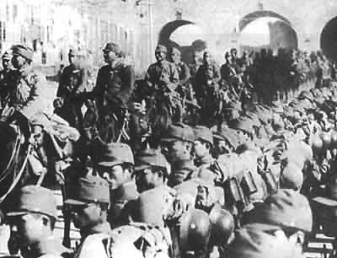
Invasion of China (July 1937)
Brutal & vicious

Slide 5
Italian Invasion of Ethiopia
Oct. 1935
Italy overruns Ethiopians
Britain allows Italy to use Suez Canal
Does not want war with Italy
League of Nations does nothing

Slide 6
Hitler Defies Versailles Treaty
Hitler’s actions raise popularity with German people
Rebuilds military (3/1935)
Occupies the Rhineland (3/1936)
Britain and France do nothing

Slide 7
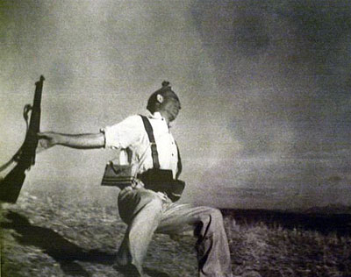
Spanish Civil War 1936
Hitler and Mussolini send troops to support Francisco Franco’s Fascist takeover of Spain
“Practice war” for German and Italian militaries

Slide 8
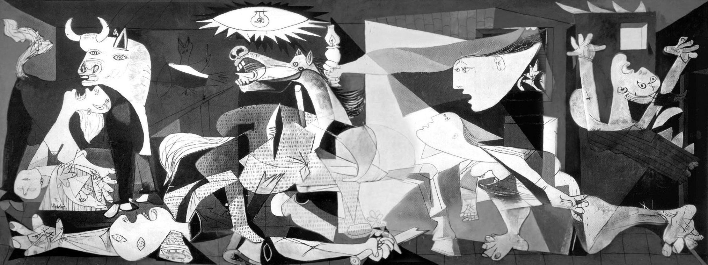

Slide 9
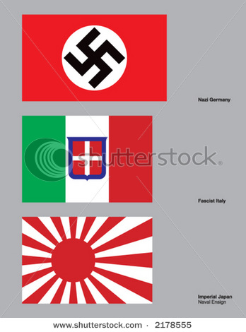
Rome-Berlin Axis 10/36
Germany and Italy form alliance

Slide 10
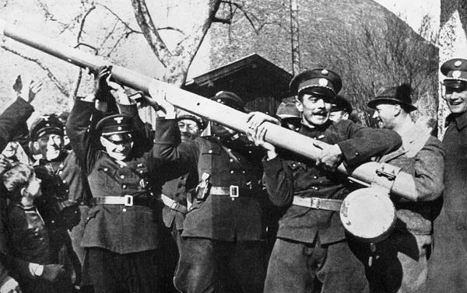
Anschluss
March 1938 Hitler annexes Austria
Prohibited by Treaty of Versailles
Britain and France do nothing

Slide 11
Munich Conference
Britain, France, Germany, and Italy meet in Munich
Germany will be allowed to take Sudetenland, promise not to take Czechoslovakia
Policy of appeasement
Giving someone what they want to keep peace
British PM Chamberlain claims “Peace in our time”
Hitler takes Czechoslovakia months later 3/1939

Slide 12
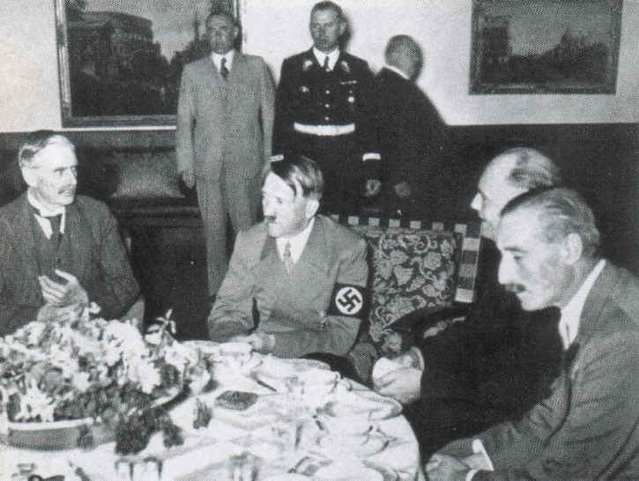
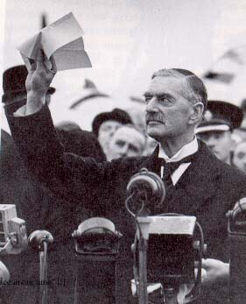

Slide 13
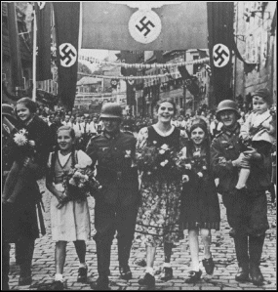
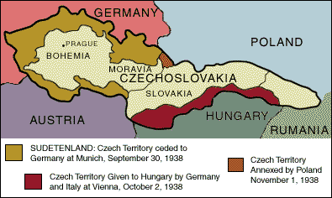
Annexation of Sudetenland
Sep 1938
Hitler claims Sudetenland area of Czechoslovakia
Full of Germans

Slide 14
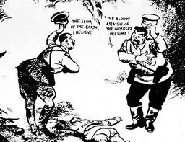
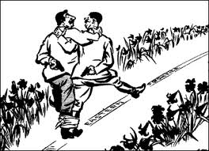
Nazi-Soviet Nonaggression Pact (8/1939)
Germany demands port of Danzig from Poland
Poles refuse
Stalin and Hitler secretly agree to divide Poland, pledge to not attack each other

Slide 15
Tripartite Act
Japan joins Axis alliance

