Slide 1
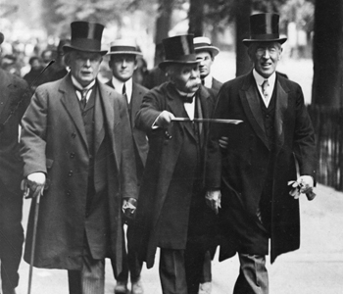
Treaty of Versailles

Slide 2
The End of the War
Final German advance stopped at the Marne
Allies counter attack
Helped by fresh American troops
Bulgaria & Ottomans surrender
Austria-Hungary losing, breaking up
Mutiny in the field, riots in Berlin
Republic declared
Kaiser Wilhelm II abdicates

Slide 3
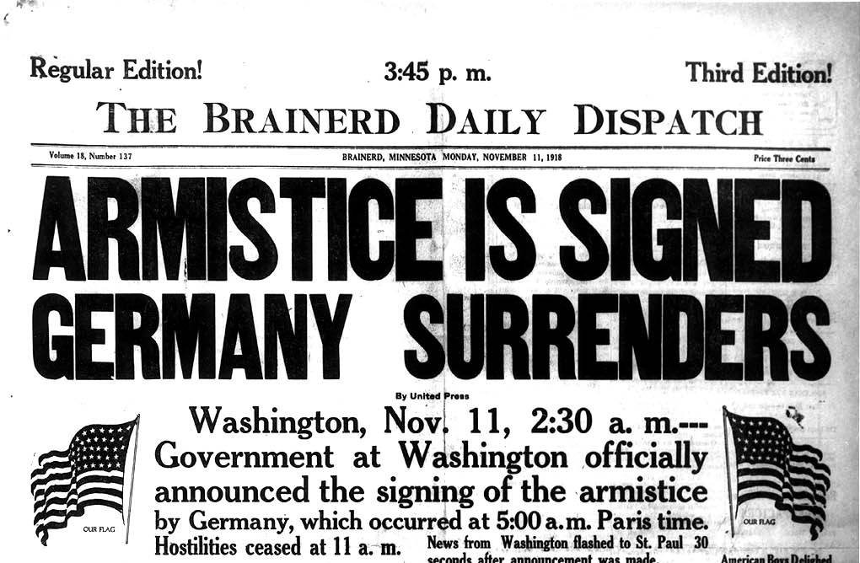
Armistice (Ceasefire)
11AM on November 11th, 1918

Slide 4
Results
8.5 million military dead
21 million wounded
$338 Billion spent

Slide 5
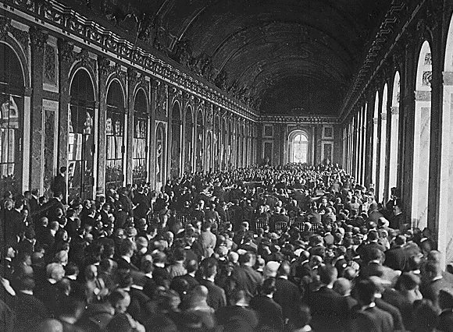
Paris Peace Conference
Meeting to decide peace terms that end WWI
32 countries attend, dominated by “Big 4”
US (Wilson)
France (Clemenceau)
Britain (Lloyd George)
Italy (Orlando)

Slide 6
The 14 Points
Wilson’s principles to create a lasting peace
End secret treaties
Free seas and trade
Reduced militaries
“Self-determination” for former colonies
Allow people to decide their own gov.’s
Creation of “League of Nations”
Group of all nations to promote peace through diplomacy

Slide 7
Treaty of Versailles 1919
Treaty that ends war with Germany
Terms
Article 231: War Guilt clause (Ger. Accepts blame for war)
Ger. Must pay reparations (pay for the whole war)
League of Nations created
German military limited
Demilitarized Rhineland
Alsace & Lorraine returned to France
French get Saar coal mines for 15 years
Ger. colonies become League “Mandates”
Areas ruled by Allies until ready for Independence
US never agrees, signs different treaty
Congress afraid of joining League of Nations

Slide 8
Territorial Decisions
East Prussia separated by “Polish Corridor”
New nations created out of lost Russian lands
Finland, Estonia, Latvia, Lithuania, Poland
Austro-Hungarian empire broken up:
Austria, Hungary, Czechoslovakia, Yugoslavia, part of Poland
Former Arab lands of Ottoman Empire divided between France and Britain
Turkey becomes secular, modern state under Kemel Ataturk
Arab lands divided by unnatural, artificial boundaries

Slide 9
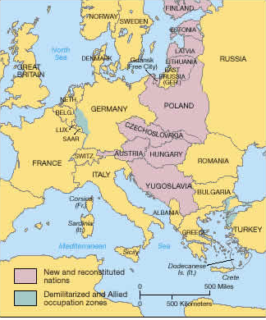

Slide 10
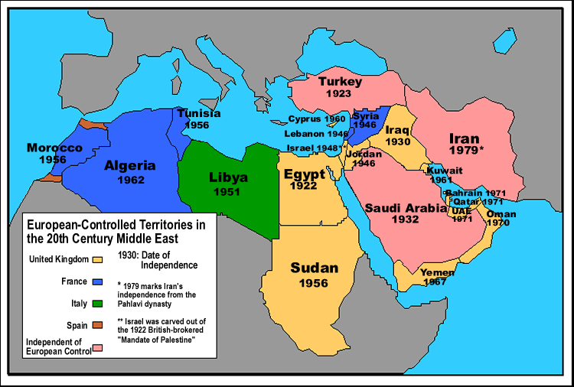

Slide 11
Reaction
Germany angry over having no say in treaty & harsh terms
US afraid of joining League of Nations, signs different treaty
Middle East angry over not getting independence
Russia not invited, a former Ally, loses more land than Germany
Japan & Italy don’t get all the land they want

Slide 12
Effects of Treaty
Creates bitterness & anger
Leads to many future conflicts
WWII
Cold War
Middle East Troubles

Slide 13
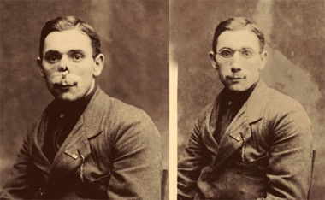

Slide 14
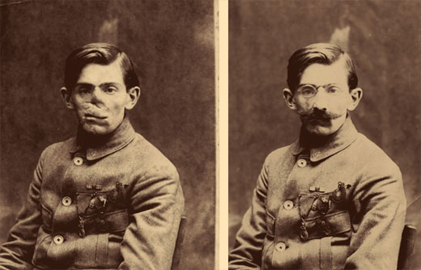

Slide 15
Effects of the War
Physical & Mental Wounds
Disillusionment (feeling of distrust)

Slide 17
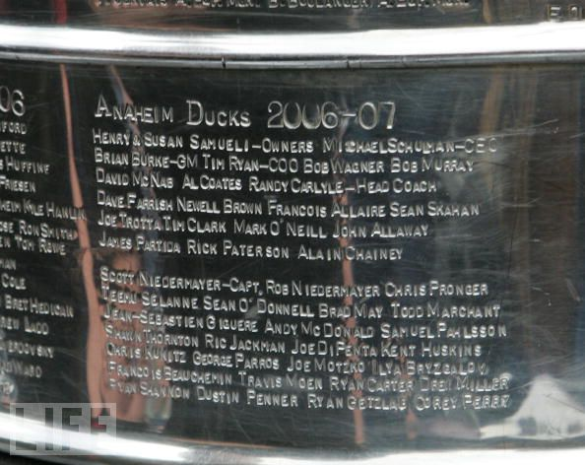
The Spanish Flu
1917/1918
Kills 30 Million worldwide

